Slide 1
Accounting Principles
Thirteenth Edition
Weygandt ● Kimmel ● Kieso
Chapter 4
Completing the Accounting Cycle
This slide deck contains animations. Please disable animations if they cause issues with your device.

Slide 2
Chapter Outline
Learning Objectives
L O 1 Prepare a worksheet.
L O 2 Prepare closing entries and a post-closing trial balance.
L O 3 Explain the steps in the accounting cycle and how to prepare correcting entries.
L O 4 Identify the sections of a classified balance sheet.

Slide 3
The Worksheet (1 of 2)
Multiple-column form used in the adjustment process and preparing financial statements
Not a permanent accounting record
May be a computerized worksheet
Prepared using a five step process
Use of worksheet is optional

Slide 4
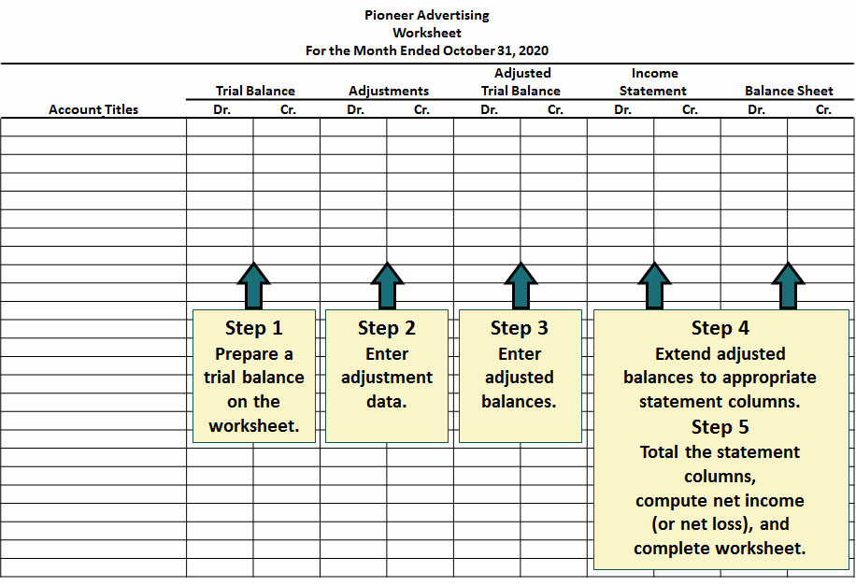
The Worksheet (2 of 2)

Slide 5
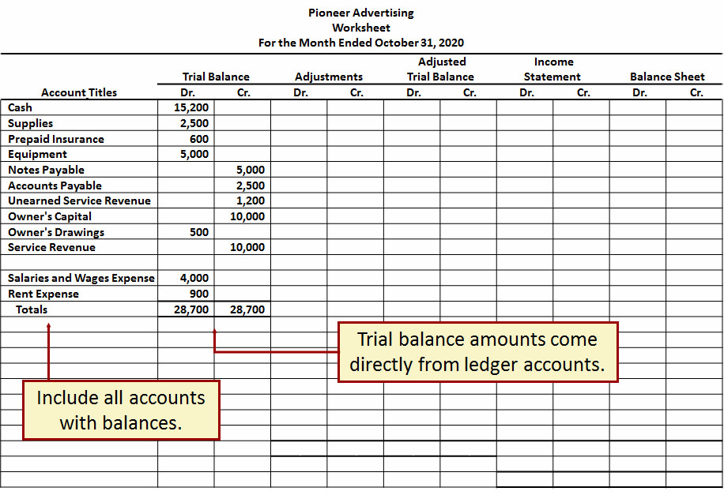
Step 1 Prepare a Trial Balance on the Worksheet

Slide 6
Step 2 Enter Adjustments
The adjustments are the same as in Illustration 3.23.
a. Pioneer debits an additional account, Supplies Expense, $1,500 for the cost of supplies used, and credits Supplies $1,500.
b. Pioneer debits an additional account, Insurance Expense, $50 for the insurance that has expired, and credits Prepaid Insurance $50.
c. The company needs two additional depreciation accounts. It debits Depreciation Expense $40 for the month’s depreciation, and credits Accumulated Depreciation—Equipment $40.
d. Pioneer debits Unearned Service Revenue $400 for services performed, and credits Service Revenue $400.
e. Pioneer debits an additional account, Accounts Receivable, $200 for services performed but not billed, and credits Service Revenue $200.
f. The company needs two additional accounts relating to interest. It debits Interest Expense $50 for accrued interest, and credits Interest Payable $50.
g. Pioneer debits Salaries and Wages Expense $1,200 for accrued salaries, and credits an additional account, Salaries and Wages Payable, $1,200.

Slide 7
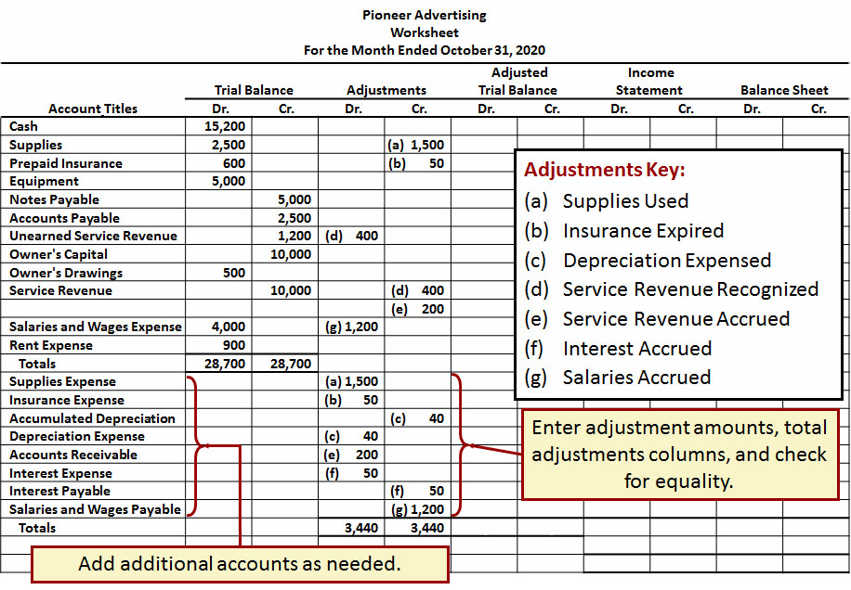
Step 2 Enter Adjustments in Adjustment Columns

Slide 8
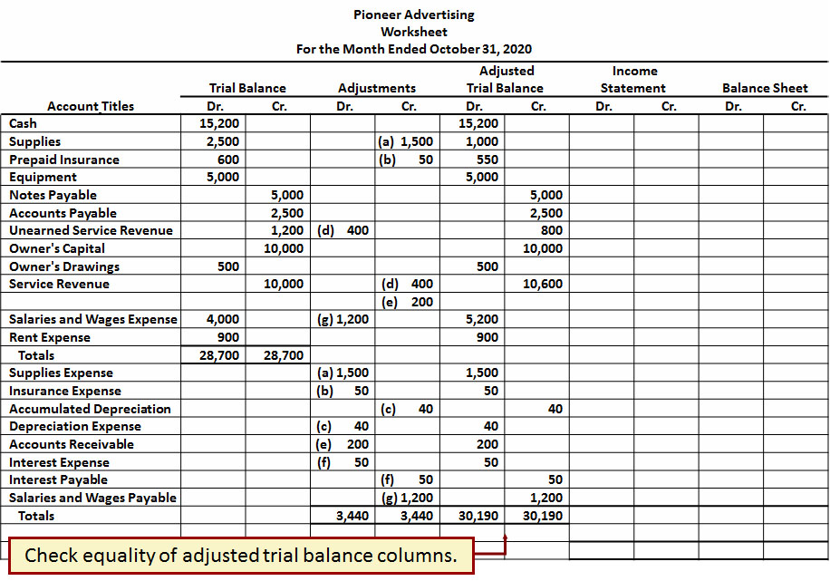
Step 3 Enter Adjusted Balances in the Adjusted Trial Balance Columns

Slide 9
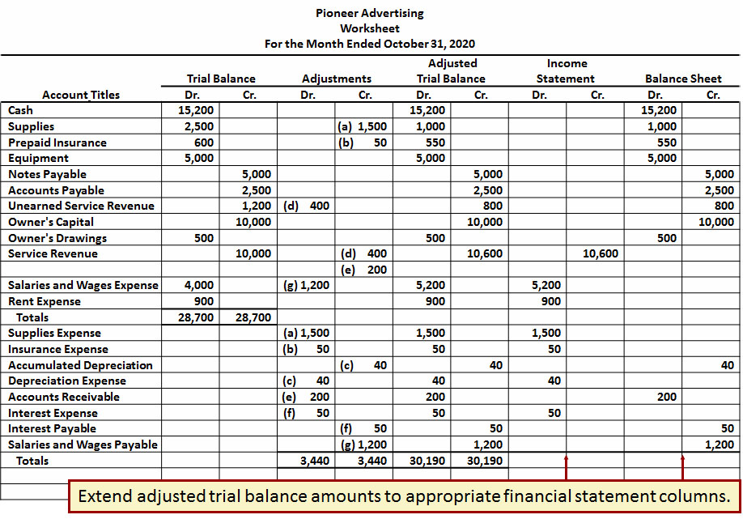
Step 4 Extend Adjusted Trial Balance Amounts to Appropriate Financial Statement Columns

Slide 10
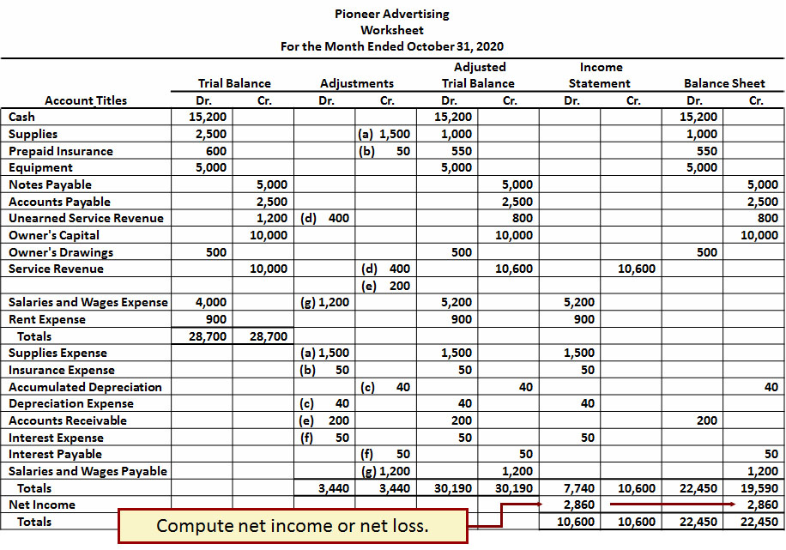
Step 5 Total the Statement Columns, Compute the Net Income (or Net Loss), and Complete the Worksheet

Slide 11
Steps in Preparing a Worksheet (1 of 2)
Net income is shown on a worksheet in the:
a. income statement debit column only.
b. balance sheet debit column only.
c. income statement credit column and balance sheet debit column.
d. income statement debit column and balance sheet credit column.

Slide 12
Steps in Preparing a Worksheet (2 of 2)
Net income is shown on a worksheet in the:
a. income statement debit column only.
b. balance sheet debit column only.
c. income statement credit column and balance sheet debit column.
d. Answer: income statement debit column and balance sheet credit column.

Slide 13
Preparing Financial Statements from a Worksheet
Income statement is prepared from the income statement columns
Balance sheet and owner’s equity statement are prepared from the balance sheet columns
Companies can prepare financial statements before they journalize and post adjusting entries

Slide 14
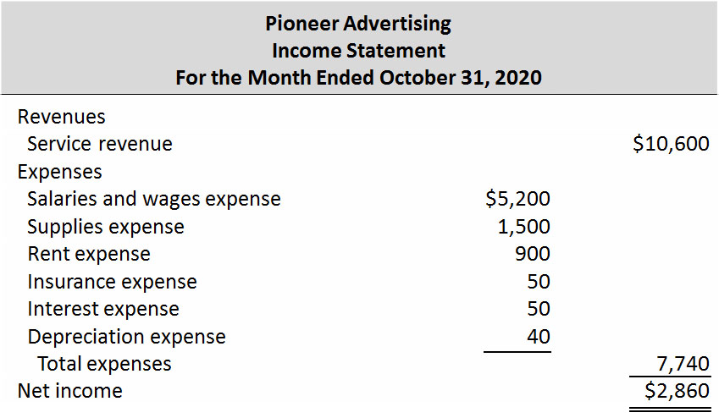
Preparing Statements from a Worksheet (1 of 3)

Slide 15
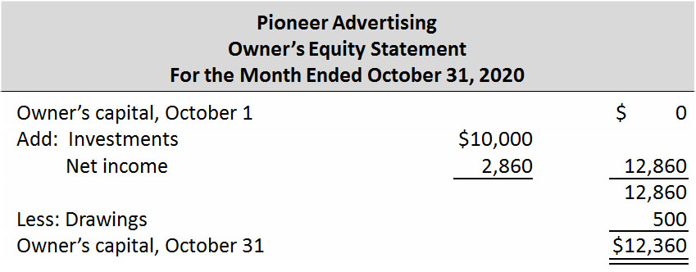
Preparing Statements from a Worksheet (2 of 3)

Slide 16
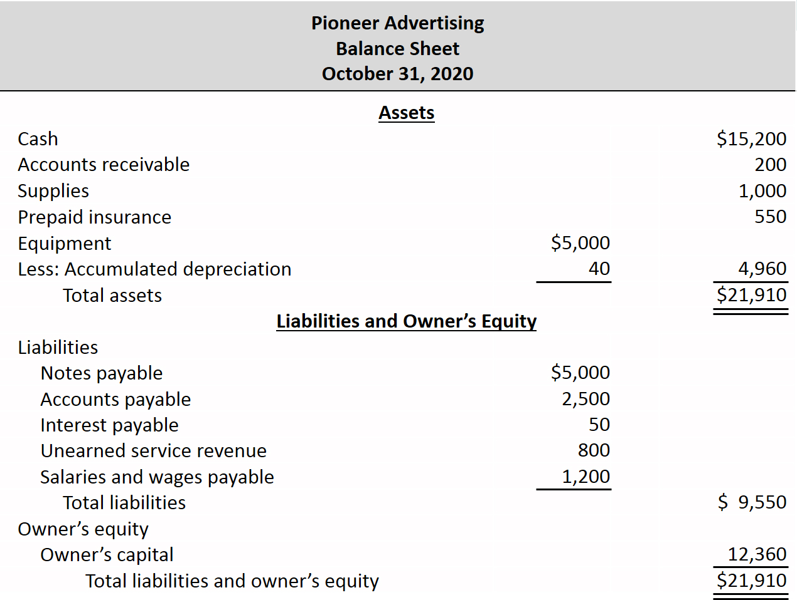
Preparing Statements from a Worksheet (3 of 3)

Slide 17
Preparing Adjusting Entries from a Worksheet
Adjusting entries are prepared from the adjustments columns of the worksheet
Journalizing and posting of adjusting entries follows the preparation of financial statements when a worksheet is used

Slide 18
Do It! 1: Worksheet
Susan Elbe is preparing a worksheet. Explain to Susan how she should extend the following adjusted trial balance accounts to the financial statement columns of the worksheet.
Cash
Balance sheet (debit)
Owner’s Drawings
Balance sheet (debit)
Accumulated Depreciation
Balance sheet (credit)
Service Revenue
Income statement (credit)
Accounts Payable
Balance sheet (credit)
Salaries and Wages Expense
Income statement (debit)

Slide 19
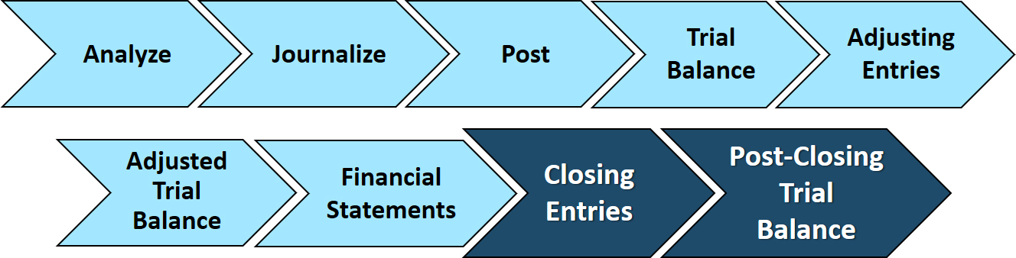
Closing the Books (1 of 2)
At the end of the accounting period, the company makes the accounts ready for the next period.

Slide 20
Closing the Books (2 of 2)
Temporary
These accounts are closed
All revenue accounts
All expense accounts
Owner's drawing account
Permanent
These accounts are not closed
All asset accounts
All liability accounts
Owner's capital account

Slide 21
Preparing Closing Entries (1 of 2)
Closing entries formally recognize in the ledger the transfer of:
Net income (or net loss) to owner’s capital.
Owner’s drawings to owner’s capital.
Produce a zero balance in each temporary account.
Companies generally journalize and post closing entries only at end of the annual accounting period.

Slide 22
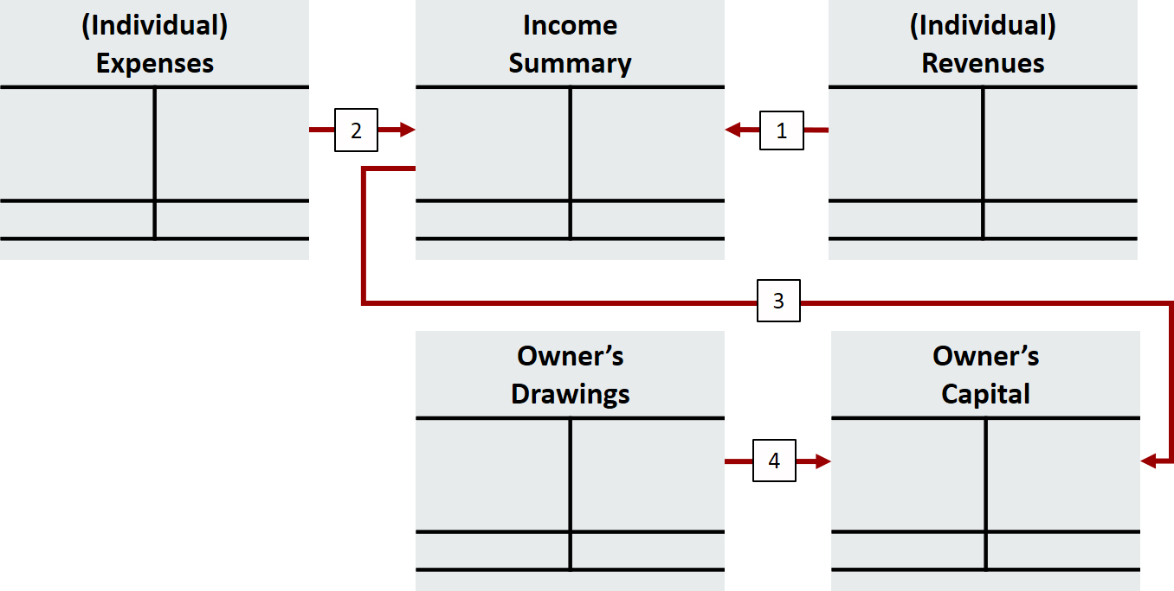
Preparing Closing Entries (2 of 2)
Key:
Close Revenues to Income Summary.
Close Expenses to Income Summary.
Close Income Summary to Owner’s Capital.
Close Owner’s Drawings to Owner’s Capital.

Slide 23
Closing Entries Illustrated (1 of 2)
 | General Journal |  |  | Page J3
Date | Account Titles and Explanations | Ref. | Debit | Credit
2020 Oct. 31 | Service Revenue | 400 | 10,600
 | Income Summary | 350 |  | 10,600
 | (To close revenue account)
31 | Income Summary | 350 | 7,740
 | Supplies Expense | 631 |  | 1,500
 | Depreciation Expense | 711 |  | 40
 | Insurance Expense | 722 |  | 50
 | Salaries and Wages Expense | 726 |  | 5,200
 | Rent Expense | 729 |  | 900
 | Interest Expense | 905 |  | 50
 | (To close expense accounts)

Slide 24
Closing Entries Illustrated (2 of 2)
 | General Journal |  |  | Page J3
Date | Account Titles and Explanations | Ref. | Debit | Credit
2020 Oct. 31 | Income Summary | 350 | 2,860
 | Owner’s Capital | 301 |  | 2,860
 | (To close net income to capital)
31 | Owner’s Capital | 301 | 500
 | Owner’s Drawings | 306 |  | 500
 | (To close drawings to capital)

Slide 25
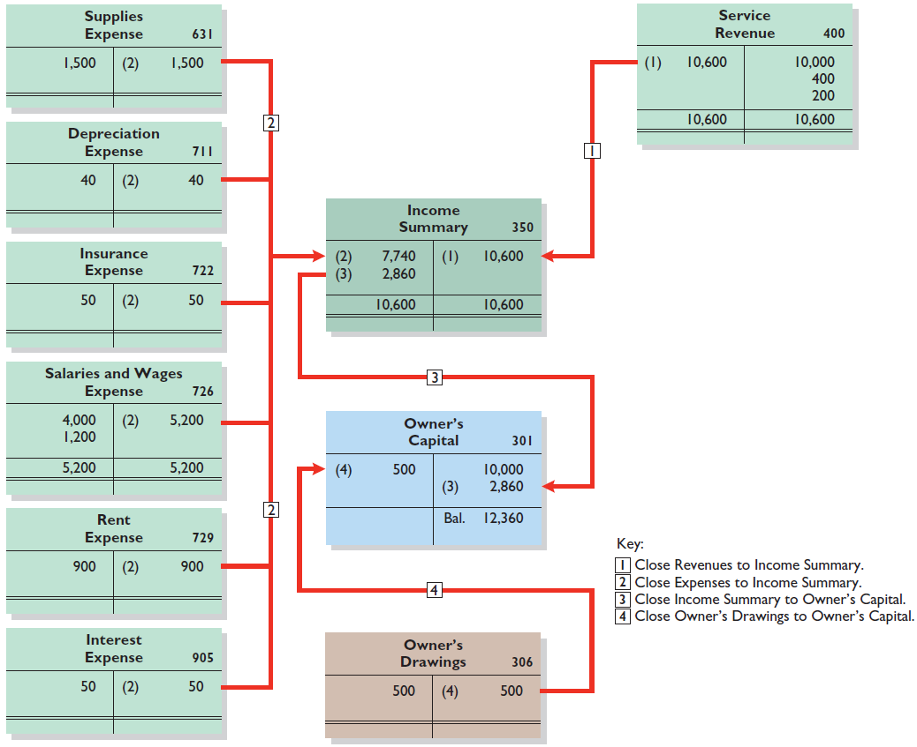
Posting Closing Entries

Slide 26
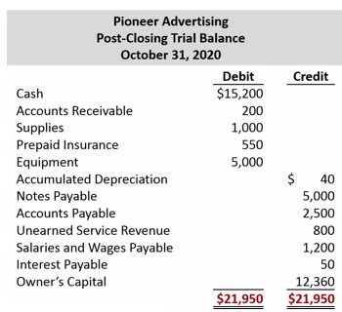
Preparing a Post-closing Trial Balance

Slide 27
Do It! 2: Closing Entries (1 of 3)
Hancock Company has the following balances in selected accounts of its adjusted trial balance.
Accounts Payable | $27,000 | Owner’s Drawings | $15,000
Service Revenue | 98,000 | Owner’s Capital | 42,000
Rent Expense | 22,000 | Accounts Receivable | 38,000
Salaries and Wages |  | Supplies Expense | 7,000
Expense | 51,000
Prepare the closing entries at December 31.
Service Revenue
98,000
Income Summary
(To close revenue account to Income Summary)
98,000

Slide 28
Do It! 2: Closing Entries (2 of 3)
Accounts Payable | $27,000 | Owner’s Drawings | $15,000
Service Revenue | 98,000 | Owner’s Capital | 42,000
Rent Expense | 22,000 | Accounts Receivable | 38,000
Salaries and Wages |  | Supplies Expense | 7,000
Expense | 51,000
Prepare the closing entries at December 31.
Income Summary
80,000
Salaries and Wages Expense
51,000
Rent Expense
22,000
Supplies Expense
(To close expense accounts to Income Summary)
7,000

Slide 29
Do It! 2: Closing Entries (3 of 3)
Accounts Payable | $27,000 | Owner’s Drawings | $15,000
Service Revenue | 98,000 | Owner’s Capital | 42,000
Rent Expense | 22,000 | Accounts Receivable | 38,000
Salaries and Wages |  | Supplies Expense | 7,000
Expense | 51,000
Prepare the closing entries at December 31.
Income Summary
18,000
Owner’s Capital
(To close net income to owner’s capital)
18,000
Owner’s Capital
15,000
Owner’s Drawings
(To close owner’s drawings to owner’s capital)
15,000

Slide 30
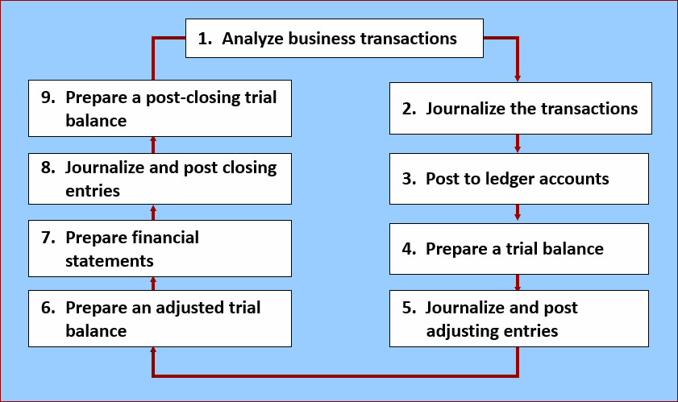
The Accounting Cycle

Slide 31
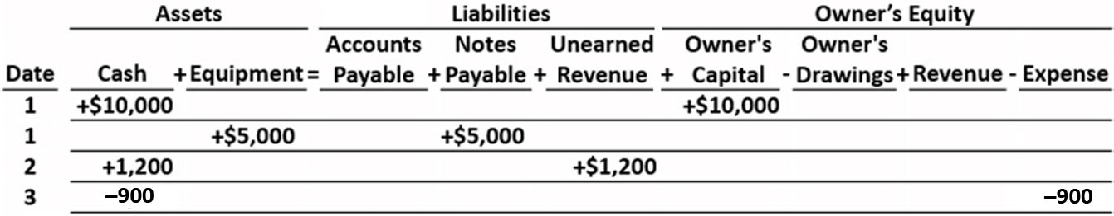
1. Analyze Business Transactions
Partial Schedule

Slide 32
2. Journalize the Transactions
 | General Journal |  |  | Page J1
Date | Explanation | Ref. | Debit | Credit
2020 Oct. 1 | Cash | 101 | 10,000
 | Owners’ Capital (Record owner's investments) | 301 |  | 10,000
1 | Equipment | 157 | 5,000
 | Notes Payable (Purchase equipment on credit) | 200 |  | 5,000
2 | Cash | 101 | 1,200
 | Unearned Revenue (Receive receipt of cash for future services) | 209 |  | 1,200
3 | Rent Expense | 729 | 900
 | Cash (Record payment of rent) | 101 |  | 900

Slide 33
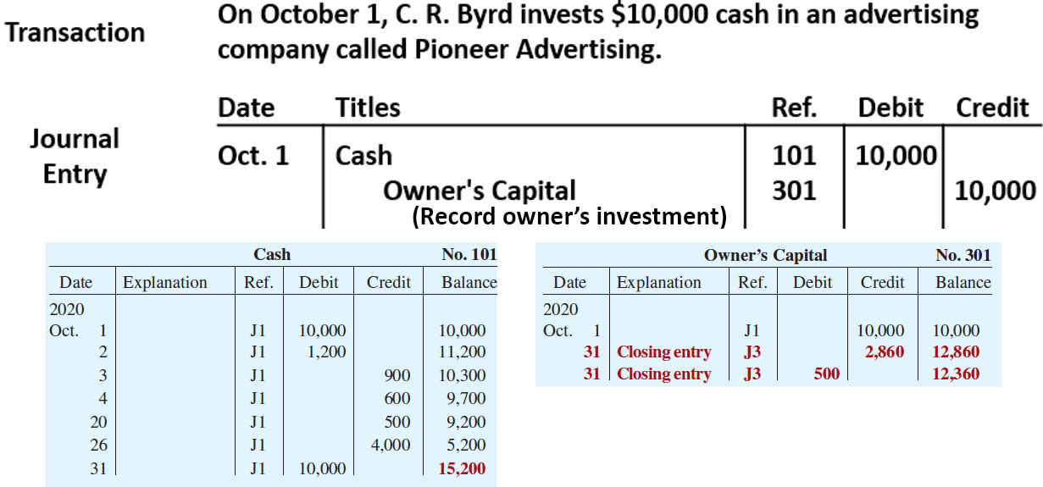
3. Post to the Ledger Accounts

Slide 34
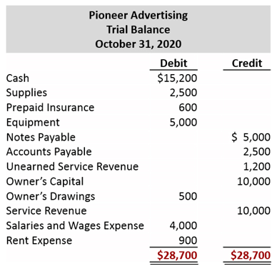
4. Prepare a Trial Balance

Slide 35
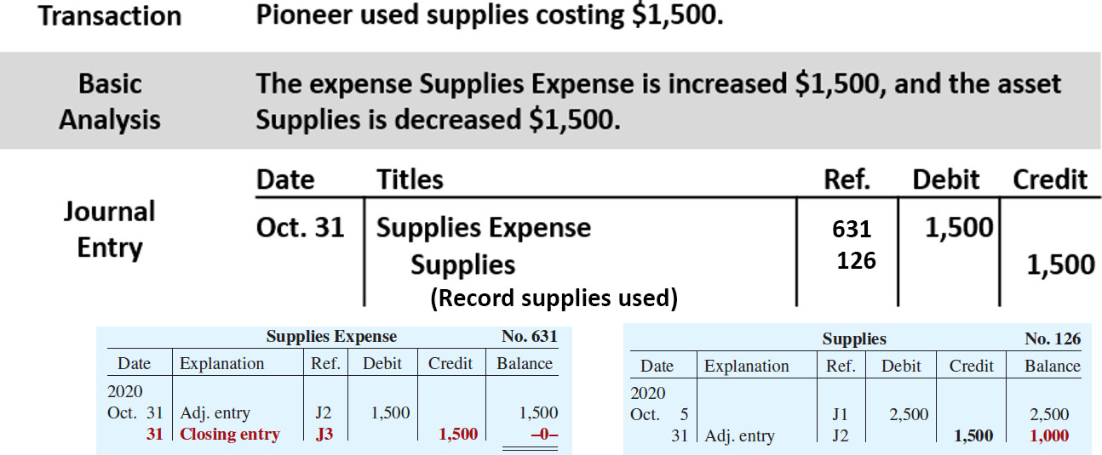
5. Journalize and Post Adjusting Entries

Slide 36
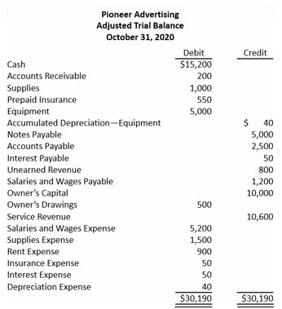
6. Prepare an Adjusted Trail Balance

Slide 37
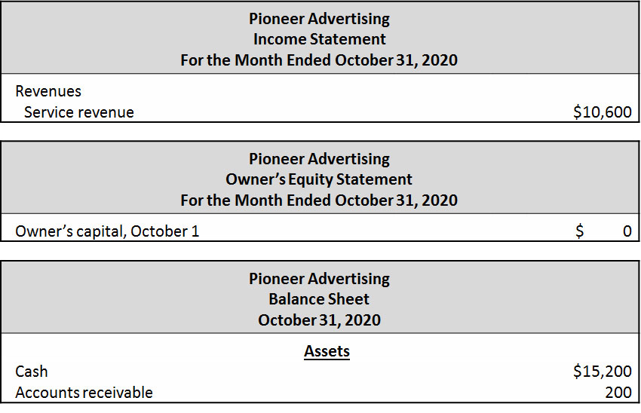
7. Prepare Financial Statements
Partial Statements

Slide 38
8. Journalize and Post Closing Entries
Partial Schedule
 | General Journal |  |  | Page J3
Date | Account Titles and Explanations | Ref. | Debit | Credit
2020 Oct. 31 | Service Revenue | 400 | 10,600
 | Income Summary | 350 |  | 10,600
 | (To close revenue account)
31 | Income Summary | 350 | 7,740
 | Supplies Expense | 631 |  | 1,500
 | Depreciation Expense | 711 |  | 40
 | Insurance Expense | 722 |  | 50
 | Salaries and Wages Expense | 726 |  | 5,200
 | Rent Expense | 729 |  | 900
 | Interest Expense | 905 |  | 50
 | (To close expense accounts)

Slide 39
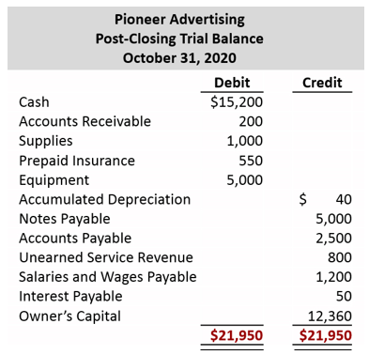
9. Prepare a Post-Closing Trial Balance

Slide 40
Correcting Entries—An Avoidable Step (1 of 3)
Unnecessary if accounting records are free of errors
Made whenever an error is discovered
Must be posted before closing entries
Instead of preparing a correcting entry, it is possible to reverse the incorrect entry and then prepare the correct entry.

Slide 41
Correcting Entries—An Avoidable Step (2 of 3)
Case 1: On May 10, Mercato Co. journalized and posted a $50 cash collection on account from a customer as a debit to Cash $50 and a credit to Service Revenue $50. The company discovered the error on May 20, when the customer paid the remaining balance in full.
Incorrect entry
Cash 50
Service Revenue 50
Correct entry
Cash 50
Accounts Receivable 50
Correcting entry
Service Revenue 50
Accounts Receivable 50

Slide 42
Correcting Entries—An Avoidable Step (3 of 3)
Case 2: On May 10, 18, Mercato purchased on account equipment costing $450. The transaction was journalized and posted as a debit to Equipment $45 and a credit to Accounts Payable $45. The error was discovered on June 3, when Mercato received the monthly statement for May from the creditor.
Incorrect entry
Equipment 45
Accounts Payable 45
Correct entry
Equipment 450
Accounts Payable 450
Correcting entry
Equipment 405
Accounts Payable 405

Slide 43
Do It! 3|Correcting Entries (1 of 3)
Sanchez Company discovered the following errors made in January 2020.
A payment of Salaries and Wages Expense of $600 was debited to Supplies and credited to Cash, both for $600.
A collection of $3,000 from a client on account was debited to Cash $200 and credited to Service Revenue $200.
The purchase of supplies on account for $860 was debited to Supplies $680 and credited to Accounts Payable $680.
Correct the errors without reversing the incorrect entry.

Slide 44
Do It! 3|Correcting Entries (2 of 3)
A payment of Salaries and Wages Expense of $600 was debited to Supplies and credited to Cash, both for $600.
Salaries and Wages Expense 600
Supplies 600
A collection of $3,000 from a client on account was debited to Cash $200 and credited to Service Revenue $200.
Service Revenue 200
Cash 2,800
Accounts Receivable 3,000

Slide 45
Do It! 3|Correcting Entries (3 of 3)
The purchase of supplies on account for $860 was debited to Supplies $680 and credited to Accounts Payable $680.
Supplies ($860 − $680) 180
Accounts Payable 180

Slide 46
Classified Balance Sheet (1 of 3)
Presents a snapshot at a point in time
To improve understanding, companies group similar assets and similar liabilities together
Assets | Liabilities and Owner's Equity
Current assets | Current liabilities
Long-term investments | Long-term liabilities
Property, plant, and equipment | Owner's (Stockholders') equity
Intangible assets

Slide 47
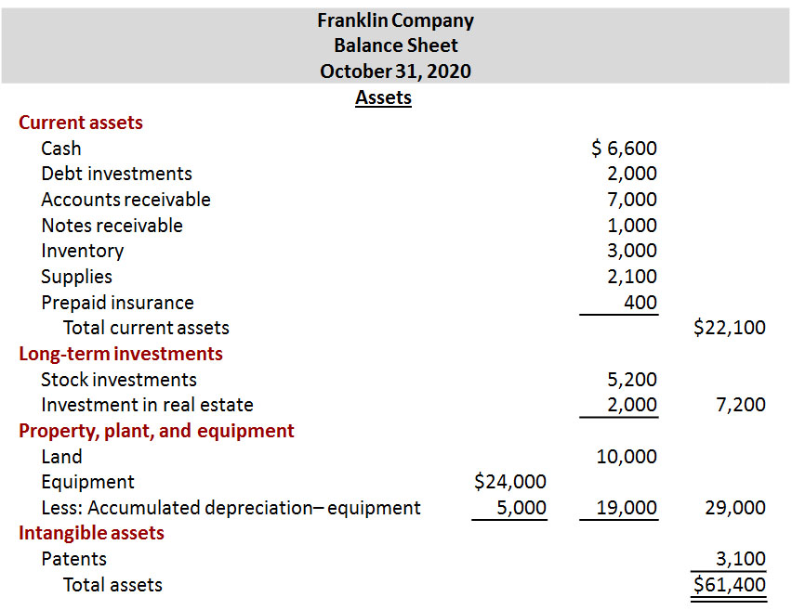
Classified Balance Sheet (2 of 3)

Slide 48
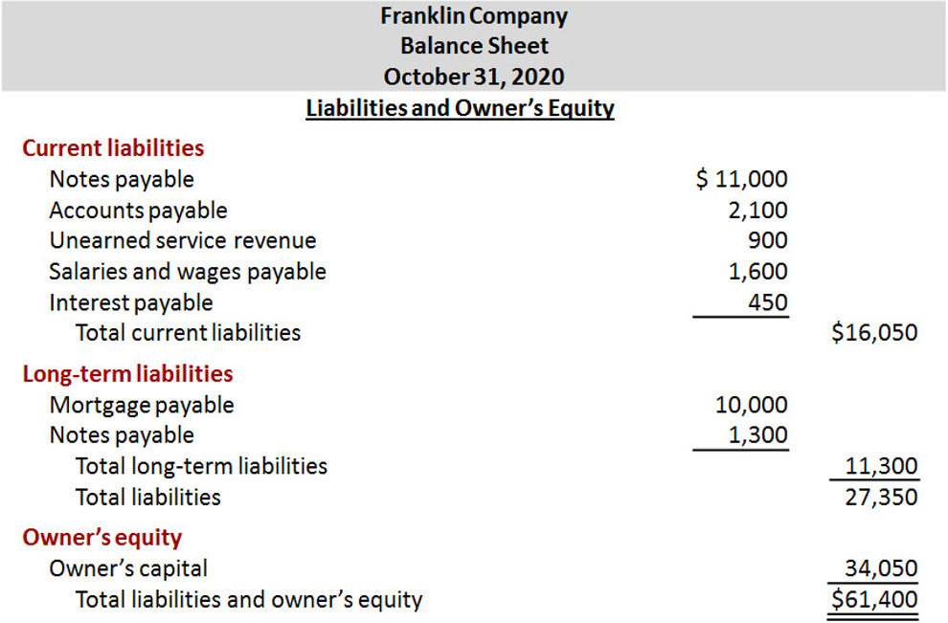
Classified Balance Sheet (3 of 3)

Slide 49
Current Assets (1 of 4)
Assets that a company expects to convert to cash or use up within one year or the operating cycle, whichever is longer
Operating cycle is the average time that it takes to
purchase inventory,
sell it on account, and
collect cash from customers

Slide 50
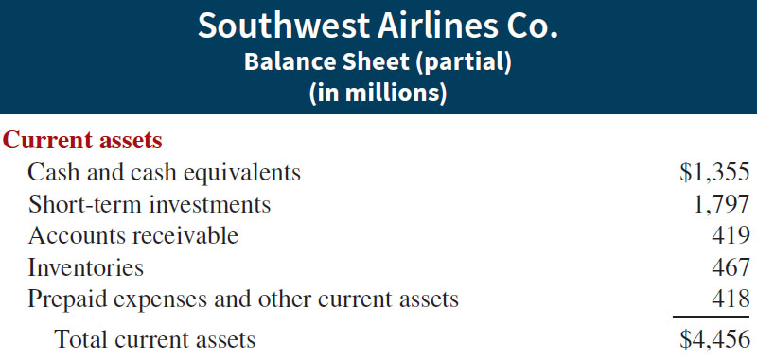
Current Assets (2 of 4)
Accounts usually listed in order in which they expect to convert them into cash.

Slide 51
Current Assets (3 of 4)
The correct order of presentation in a classified balance sheet for the following current assets is:
a. accounts receivable, cash, prepaid insurance, inventory.
b. cash, inventory, accounts receivable, prepaid insurance.
c. cash, accounts receivable, inventory, prepaid insurance.
d. inventory, cash, accounts receivable, prepaid insurance.

Slide 52
Current Assets (4 of 4)
The correct order of presentation in a classified balance sheet for the following current assets is:
a. accounts receivable, cash, prepaid insurance, inventory.
b. cash, inventory, accounts receivable, prepaid insurance.
c. Answer: cash, accounts receivable, inventory, prepaid insurance.
d. inventory, cash, accounts receivable, prepaid insurance.

Slide 53
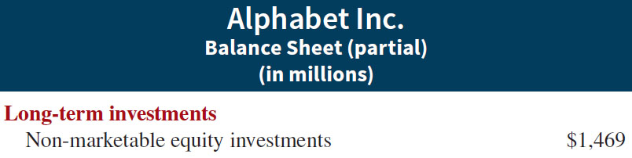
Long-Term Investments
Investments in stocks and bonds of other companies
Investments in long-term assets such as land or buildings that are not currently being used in operating activities
Long-term notes receivable

Slide 54
Property, Plant, and Equipment (1 of 2)
Long useful lives
Currently used in operations
Includes land, buildings, machinery and equipment, delivery equipment, and furniture
Depreciation - allocating the cost of assets to a number of years
Accumulated depreciation - total amount of depreciation expensed thus far in the asset’s life

Slide 55
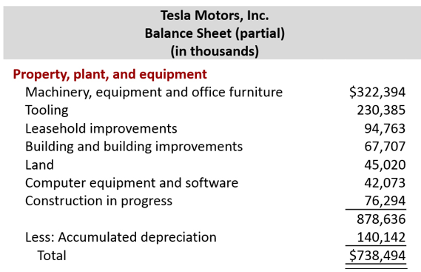
Property, Plant, and Equipment (2 of 2)

Slide 56
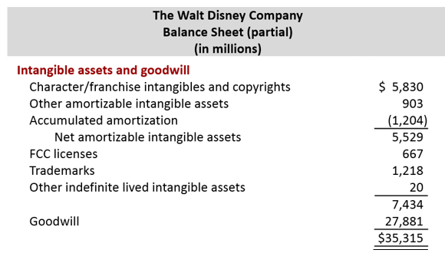
Intangible Assets
Long-lived assets that do not have physical substance

Slide 57
Classified Balance Sheet (1 of 4)
Patents and copyrights are
a. Current assets
b. Intangible assets
c. Long-term investments
d. Property, plant, and equipment

Slide 58
Classified Balance Sheet (2 of 4)
Patents and copyrights are
a. Current assets
b. Answer: Intangible assets
c. Long-term investments
d. Property, plant, and equipment

Slide 59
Current Liabilities (1 of 2)
Obligations company is to pay within the coming year or its operating cycle, whichever is longer
Usually list notes payable first, followed by accounts payable. Other items follow in order of magnitude
Common examples are accounts payable, salaries and wages payable, notes payable, interest payable, income taxes payable and current maturities of long-term obligations
Liquidity - ability to pay obligations expected to be due within the next year

Slide 60
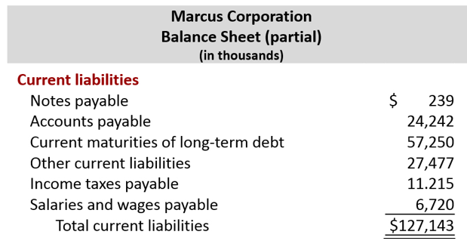
Current Liabilities (2 of 2)

Slide 61
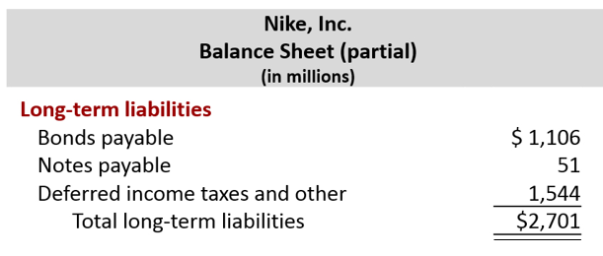
Long-Term Liabilities
Obligations a company expects to pay after one year.

Slide 62
Classified Balance Sheet (3 of 4)
Which of the following is not a long-term liability?
a. Bonds payable
b. Current maturities of long-term obligations
c. Long-term notes payable
d. Mortgages payable

Slide 63
Classified Balance Sheet (4 of 4)
Which of the following is not a long-term liability?
a. Bonds payable
b. Answer: Current maturities of long-term obligations
c. Long-term notes payable
d. Mortgages payable

Slide 64
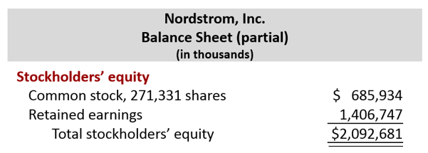
Owner’s Equity
Proprietorship - one capital account
Partnership - capital account for each partner
Corporation - Common Stock and Retained Earnings

Slide 65
Do It! 4 | Balance Sheet Classifications (1 of 2)
Match each of the following to its proper balance sheet classification, shown below. If the item would not appear on a balance sheet, use “N A.”
_____ Salaries and wages payable
_____ Service revenue
_____ Interest payable
_____ Goodwill
_____ Debt investments (short-term)
_____ Mortgage payable (due in 3 years)
_____ Stock investments (long-term)
_____ Equipment
_____ Accumulated depreciation—equipment
_____ Depreciation expense
_____ Owner’s capital
_____ Unearned service revenue
Current assets (C A)
Long-term investments (L T I)
Property, plant, and equipment (P P E)
Intangible assets (I A)
Current liabilities (C L)
Long-term liabilities (L T L)
Owner’s equity (O E)

Slide 66
Do It! 4 | Balance Sheet Classifications (2 of 2)
Match each of the following to its proper balance sheet classification, shown below. If the item would not appear on a balance sheet, use “N A.”
__C L__ Salaries and wages payable
__N A__ Service revenue
__C L__ Interest payable
__I A__ Goodwill
__C A__ Debt investments (short-term)
__L T L_ Mortgage payable (due in 3 years)
__L T I__ Stock investments (long-term)
__P P E_ Equipment
__P P E_ Accumulated depreciation depreciation—equipment
__N A__ Depreciation expense
__O E__ Owner’s capital
__C L__ Unearned service revenue
Current assets (C A)
Long-term investments (L T I)
Property, plant, and equipment (P P E)
Intangible assets (I A)
Current liabilities (C L)
Long-term liabilities (L T L)
Owner’s equity (O E)

Slide 67
Appendix 4A Reversing Entries
It is often helpful to reverse some adjusting entries before recording regular transactions of the next period
Companies make a reversing entry at beginning of next accounting period
Each reversing entry is the exact opposite of adjusting entry made in previous period
Use of reversing entries does not change amounts reported in the financial statements
Reversing entries are optional; purpose of reversing entries is to simplify the recording of a subsequent transaction

Slide 68
Reversing Entries Example (1 of 3)
We use the salaries expense transactions for Pioneer Advertising as illustrated in Chapters 2, 3, and 4.
October 26 (initial salary entry): Pioneer pays $4,000 of salaries and wages earned between October 15 and October 26.
October 31 (adjusting entry): Salaries and wages earned between October 29 and October 31 are $1,200. The company will pay these in the November 9 payroll.
November 9 (subsequent salary entry): Salaries and wages paid are $4,000. Of this amount, $1,200 applied to accrued salaries and wages payable and $2,800 was earned between November 1 and November 9.

Slide 69
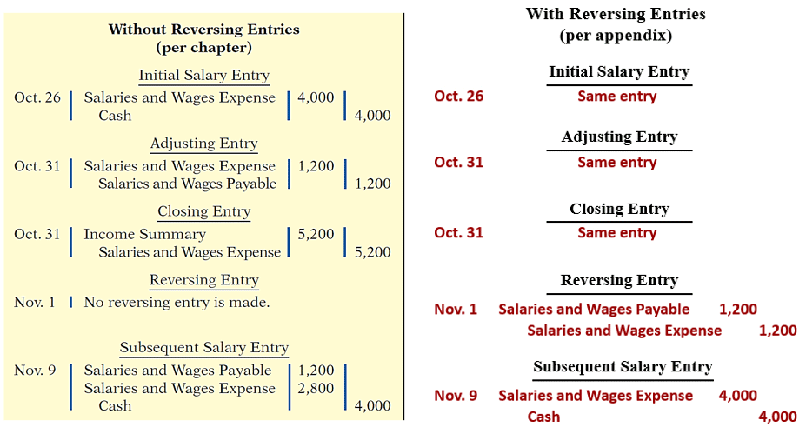
Reversing Entries Example (2 of 3)

Slide 70
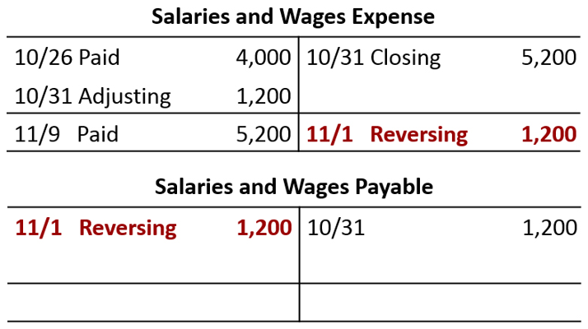
Reversing Entries Example (3 of 3)

Slide 71
A Look at I F R S (1 of 4)
Key Points
Similarities
The procedures of the closing process are applicable to all companies, whether they are using I F R S or G A A P.
I F R S generally requires a classified statement of financial position similar to the classified balance sheet under G A A P.
I F R S follows the same guidelines as G A A P for distinguishing between current and non-current assets and liabilities.

Slide 72
A Look at I F R S (2 of 4)
Key Points
Differences
IFRS recommends but does not require the use of the title “statement of financial position” rather than balance sheet.
The format of statement of financial position information is often presented differently under IFRS. Although no specific format is required, many companies that follow IFRS present statement of financial position information in this order:
Non-current assets
Current assets
Equity
Non-current liabilities
Current liabilities

Slide 73
A Look at I F R S (3 of 4)
Key Points
Differences
Under I F R S, current assets are usually listed in the reverse order of liquidity. For example, under G A A P cash is listed first, but under I F R S it is listed last.
I F R S has many differences in terminology from what are shown in your textbook.
Both G A A P and I F R S are increasing the use of fair value to report assets. However, at this point I F R S has adopted it more broadly. As examples, under I F R S, companies can apply fair value to property, plant, and equipment, and in some cases intangible assets.

Slide 74
A Look at I F R S (4 of 4)
Looking to the Future
The I A S B and the F A S B are working on a project to converge their standards related to financial statement presentation. A key feature of the proposed framework is that each of the statements will be organized in the same format, to separate an entity’s financing activities from its operating and investing activities and, further, to separate financing activities into transactions with owners and creditors. Thus, the same classifications used in the statement of financial position would also be used in the income statement and the statement of cash flows. The project has three phases. You can follow the joint financial presentation project at the F A S B website.

Slide 75
Copyright
Copyright © 2018 John Wiley & Sons, Inc.
All rights reserved. Reproduction or translation of this work beyond that permitted in Section 117 of the 1976 United States Act without the express written permission of the copyright owner is unlawful. Request for further information should be addressed to the Permissions Department, John Wiley & Sons, Inc. The purchaser may make back-up copies for his/her own use only and not for distribution or resale. The Publisher assumes no responsibility for errors, omissions, or damages, caused by the use of these programs or from the use of the information contained herein.

